Slide 1
MFE Python Course
Advanced Python Programming, Part 2

Slide 2
Welcome Back
Part I, review:
MCPs, Skills, Code as a tool for agents
Scoping
Memory model
Imports
Functional programming (pure vs. impure)
Decorators (functions as first-class objects)
Object oriented programming (Ontology)
Iterators and generators
Today’s focus: Performance, optimization, and production practices

Slide 3
Lesson Overview
Recursion
Performance optimization
Data structures deep dive
Concurrency
Product best practices
What you’ll be able to do after this session

Slide 4
Recursion

Slide 5
Recursion Fundamentals
What is Recursion?
- A function that solves a problem by calling itself with smaller subproblems
- Think of it as "divide and conquer" - breaking big problems into smaller, similar ones
Base Case vs Recursive Case
- Base Case: The simplest scenario where we return directly without recursion
- Recursive Case: Where we break down the problem and make recursive calls
When to Use Recursion
- Tree/graph traversal
- Divide & conquer algorithms
- Problems with recursive mathematical definitions
- When code clarity is more important than performance

Slide 6
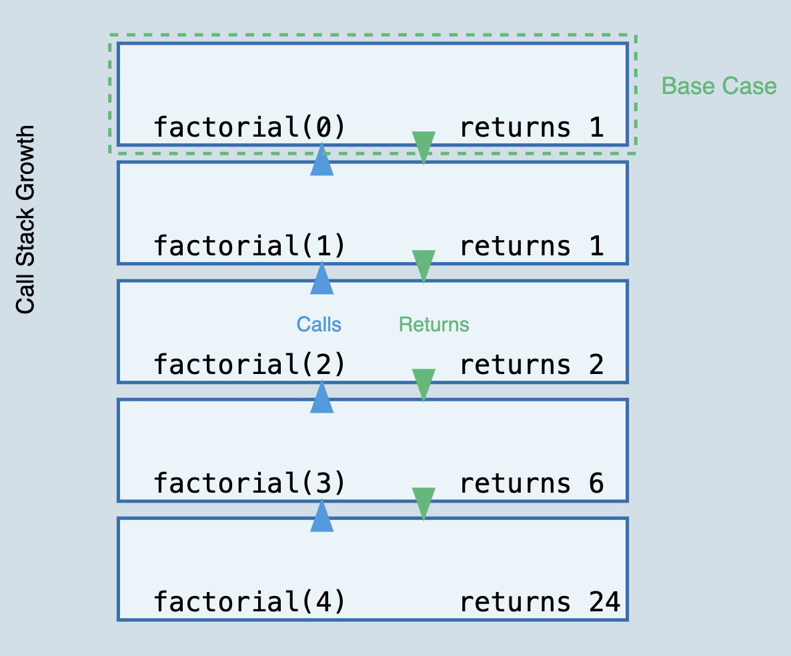
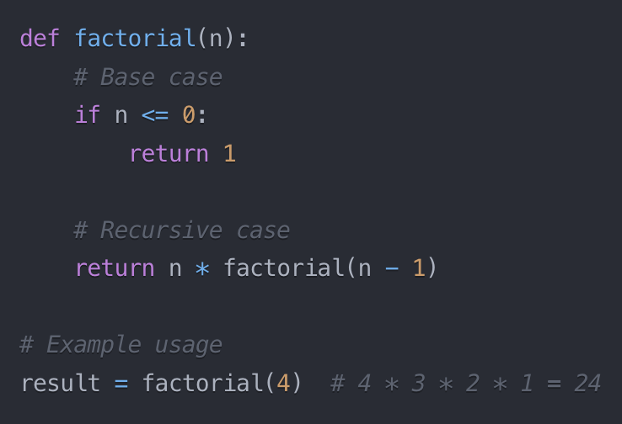
Basic Recursion Example

Slide 7
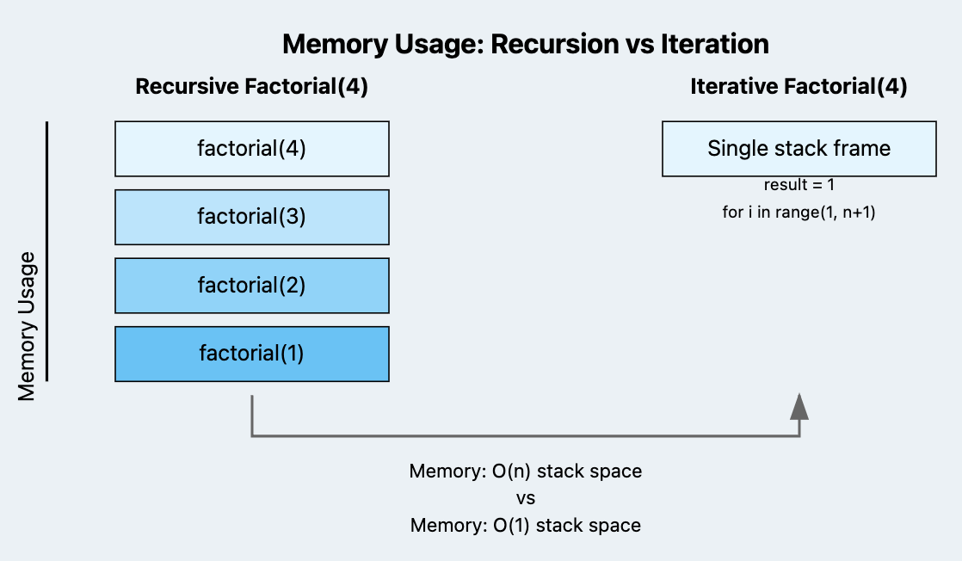
Recursion vs Iteration: Making the Right Choice
When Recursion Shines:
- Tree/Graph traversals (DFS, backtracking)
- Problems with recursive mathematical definition
- Fibonacci, factorial, fractal patterns
- Divide-and-conquer algorithms
- Merge sort, quicksort
- Problems that naturally break into subproblems
- Tower of Hanoi, combination generation
Performance Tradeoffs:
- Space Complexity
- Each recursive call adds to call stack
- Risk of stack overflow for deep recursion
- Time Complexity
- Often identical to iterative solution
- Overhead from function call stack management
Interview Strategy:
- Key Patterns: Trees, Backtracking, Divide & Conquer
- Consider recursion when subproblems are identical
- Always mention space complexity trade-offs
- Be ready to convert recursive to iterative

Slide 8
Performance & Optimization

Slide 9
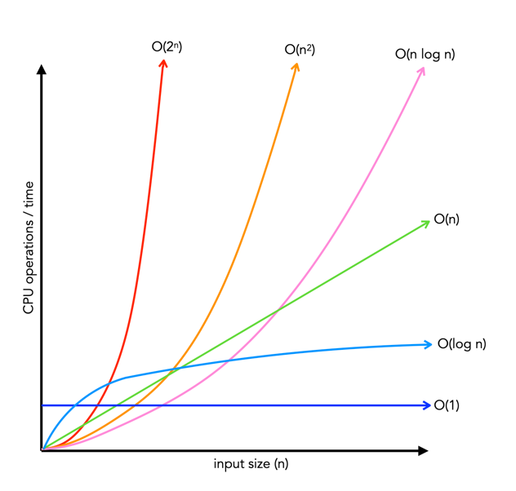
Big O Notation
What is Big O?
- Measures how runtime/space grows with input size
- Describes worst-case performance scenario
- Ignores constants and smaller terms
Why It Matters
- Predict performance at scale
- Choose right data structures
- Critical for financial applications with large datasets
- Optimize resource-intensive operations
Interview Perspective
- Standard question in tech interviews
- Focus on recognizing common patterns
- Must justify algorithmic choices
- Trade-offs between time and space complexity

Slide 10
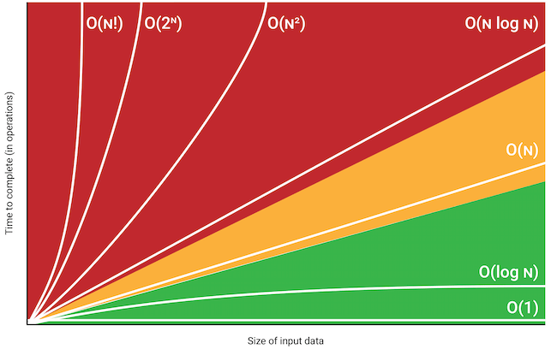
Complexity Classes
O(1) - Constant
O(log n) - Logarithmic
O(n) - Linear
O(n log n) - Log-linear
O(n^2) - Quadratic

Slide 11


Slide 12


Slide 13
Practical Guide for Evaluating Big O Complexity
1. First, identify all loops in the code and their nesting level
Single loop = O(n)
Nested loop = O(n^k) where k is the number of nested levels
Example: Two nested loops is O(n²), three nested loops is O(n³)
2. Look for keywords that indicate operations on the entire input
.sort() is typically O(n log n)
Creating a new array/list of the same size is O(n)
Single operations like accessing an array index or dictionary key are O(1)
3. Check how the input size affects the iterations
If you only look at the first/last k elements regardless of input size = O(1)
If you look at half the elements = still O(n)
If you divide input size in each step (like binary search) = O(log n)
4. For recursive functions:
Count how many times the function calls itself
Check if the input size is reduced in each call
Example: Binary search is O(log n) because it halves input each time
Example: Merge sort is O(n log n) because it divides input and then merges

Slide 14
Practical Guide for Evaluating Big O Complexity
5. Always consider the worst case scenario
Quick sort average case: O(n log n)
Quick sort worst case: O(n²)
HashMap lookup average: O(1)
HashMap lookup worst case: O(n)
6. The largest term dominates
O(n² + n + 1) simplifies to just O(n²)
O(n log n + n) simplifies to O(n log n)
O(2^n + n²) simplifies to O(2^n)

Slide 15
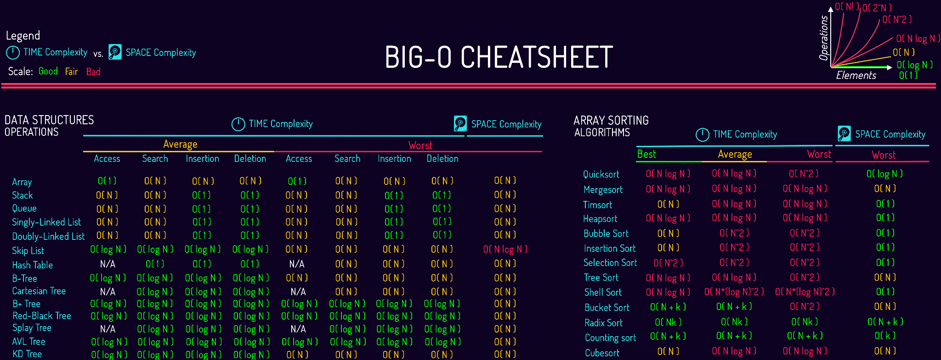

Slide 16
Data Structures Overview
Common Data Structures
- Lists, Arrays, Tuples: Ordered sequences
- Dictionaries (Hash Tables): Key-value pairs
- Sets: Unique unordered elements
- Trees: Hierarchical data
- Heaps: Priority queues
- Graphs: Network relationships
Time/Space Trade-offs
- Lists vs Sets for lookups
- Arrays vs Linked Lists for insertion
- Hash Tables vs Trees for ordering
- Consider both memory and speed requirements
Key Considerations
- Data access patterns
- Insertion/deletion frequency
- Memory constraints
- Ordering requirements

Slide 17
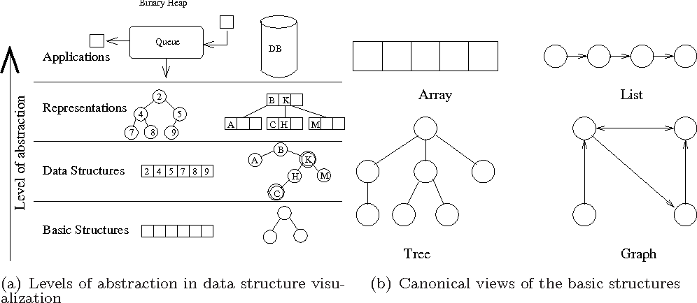
Data Structures Visualized

Slide 18
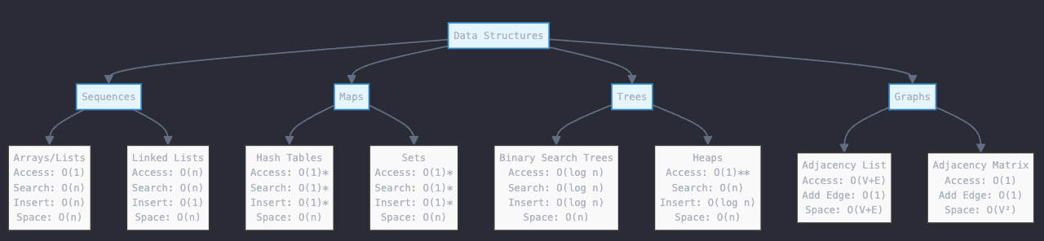
Data Structures - Time and Space Complexity

Slide 19
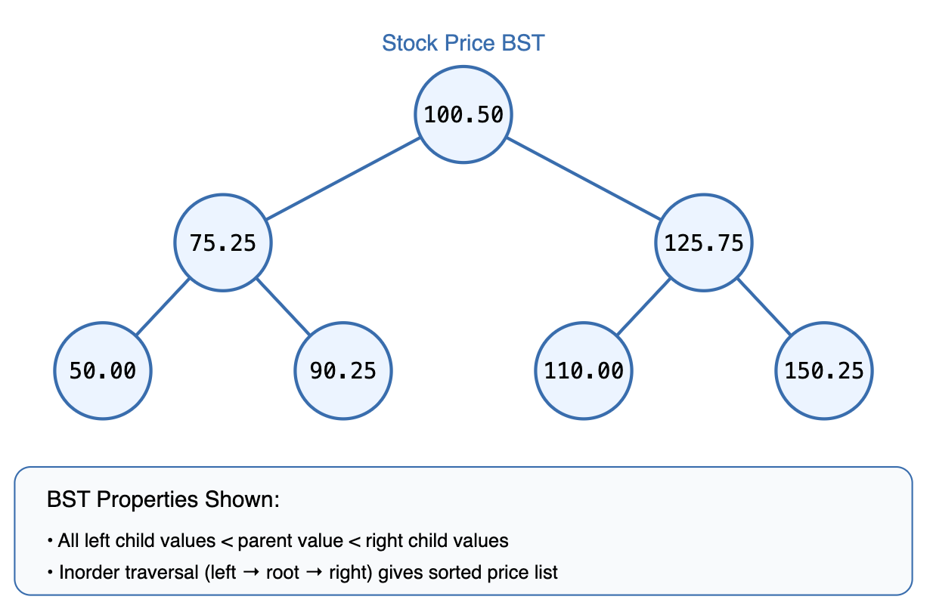
Binary Search Tree
Why It's Important
- Efficient searching and sorting (O(log n))
- Natural for maintaining ordered data
- Perfect for range queries in financial data
- Most common tree structure in interviews
Key Properties
- Left subtree < node < right subtree
- Balanced trees guarantee O(log n) operations
- Self-balancing variants (AVL, Red-Black) maintain efficiency
- Inorder traversal gives sorted output
Common Applications
- Order books and price levels
- Time series data indexing
- Range queries (price bands)
- Portfolio hierarchy management

Slide 20


Slide 21
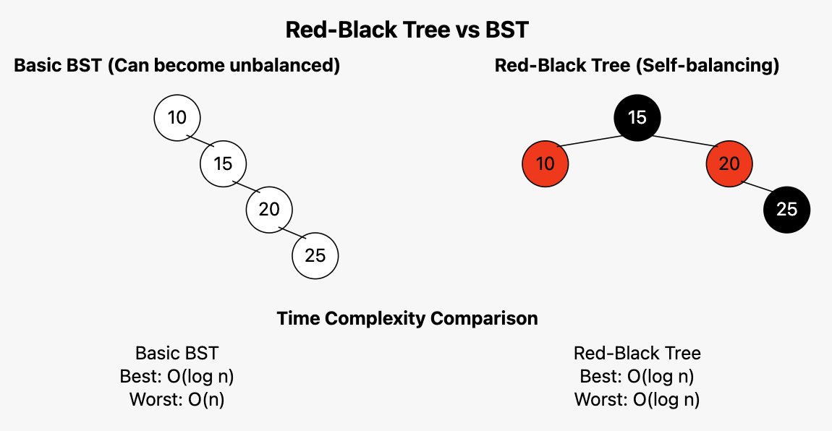
Red-Black Trees: Self-Balancing Search
Key Properties:
- Every node is either red or black
- Root and leaves (NIL) are black
- Red nodes can't have red children
- Every path from root to leaves has same
number of black nodes (black-height)
Why Better Than BST:
- Guaranteed O(log n) operations
- No degeneration into linear structure
- Automatic rebalancing via color rules
- Perfect for continuous inserts/deletes
Example Use Cases:
- Order book price levels
- Java TreeMap implementation
- Linux kernel process scheduling

Slide 22
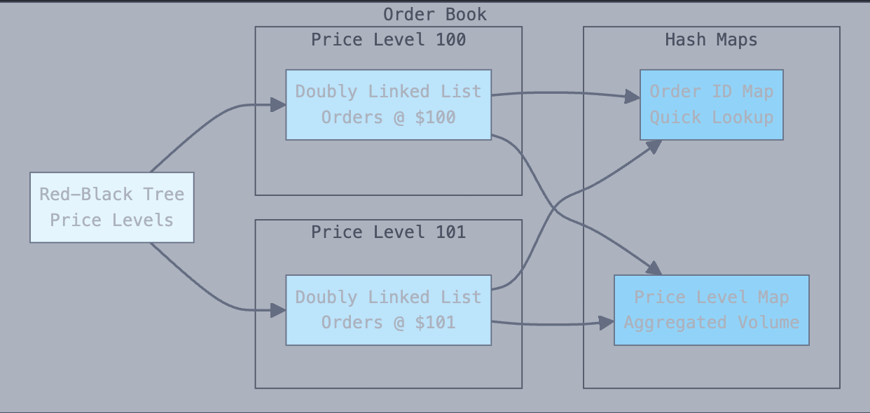
Order Book Implementation: Data Structures Deep Dive
Core Requirements:
- Fast price-level matching
- Quick order insertion/cancellation
- Efficient best bid/ask lookups
- Memory-efficient storage
- Thread-safe operations
Key Data Structures:
- Price Levels: Red-Black Tree
- O(log n) insertion/deletion
- O(1) min/max (best bid/ask)
- Built-in order maintenance
- Individual Orders: Hash Map + Doubly Linked List
- O(1) order lookup by ID
- O(1) order cancellation
- Memory efficient for order storage
- Price Aggregation: Hash Map
- O(1) volume lookup at price level
- Quick price-level statistics

Slide 23
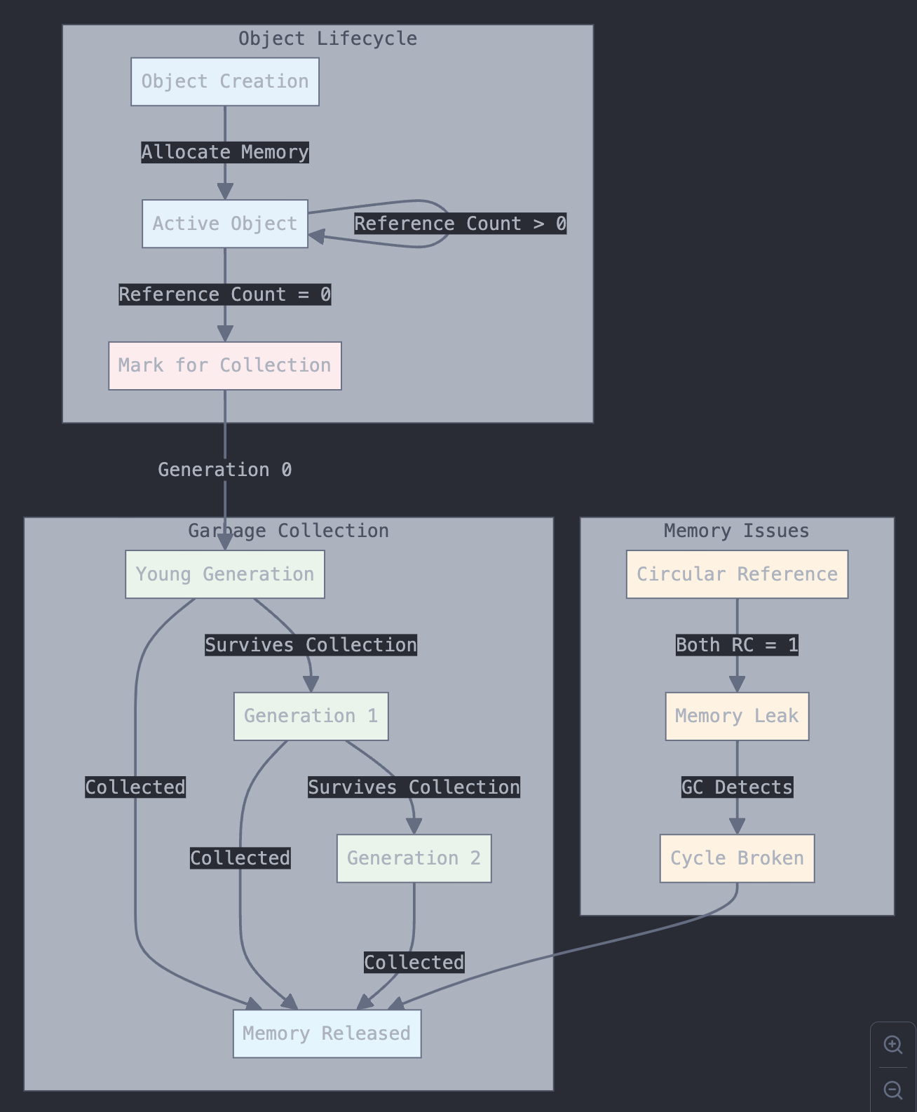
Memory Management
Python's Memory Model
- Objects stored in private heap space
- Reference counting for memory tracking
- Memory manager handles allocation
- Object lifecycle: creation → reference → cleanup
Garbage Collection
- Automatic memory cleanup
- Reference counting + generational GC
- Cyclic references handled automatically
- Manual cleanup rarely needed

Slide 24
Memory Management
Common Memory Issues
- Memory leaks from circular references
- Large objects not being released
- Global variables accumulating data
- Cache growing unbounded
Profiling Tools
- memory_profiler for line-by-line analysis
- tracemalloc for object allocation tracking
- gc module for manual garbage collection
- psutil for system-wide memory monitoring

Slide 25
Concurrency

Slide 26
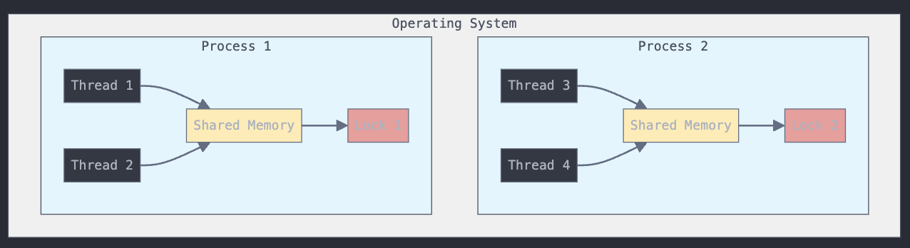
Concurrent Programming Fundamentals
Processes:
- Independent units of execution with separate memory spaces
- Example: Running multiple Python scripts simultaneously
- Heavy but isolated - great for CPU-intensive tasks
Threads:
- Lightweight units that share memory within a process
- All threads in a process share memory and resources
- Great for I/O-bound tasks (e.g., reading files, API calls)
Memory Management:
- Global Interpreter Lock (GIL) - Only one thread executes Python code at a time
- Shared memory between threads can lead to race conditions
- Processes have memory isolation but higher overhead
Critical Sections & Locks:
- Critical sections: Parts of code where shared resources are accessed
- Locks prevent multiple threads from simultaneously accessing shared resources
- Example: Multiple threads updating the same bank account balance

Slide 27
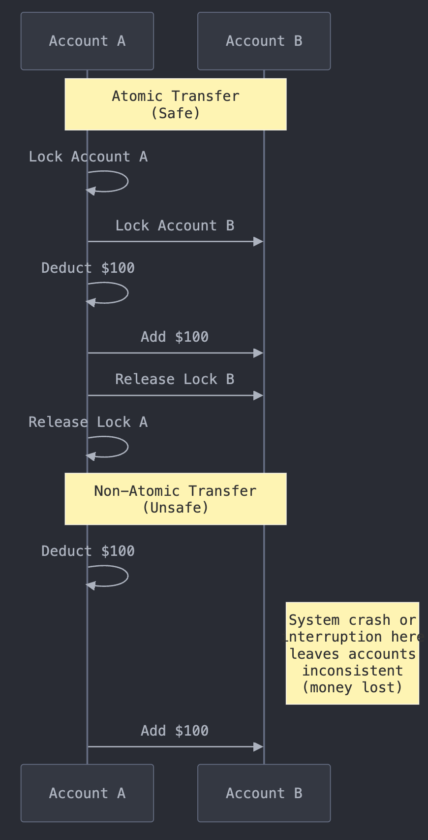
Understanding Atomicity
What is Atomicity?
- Operations that must execute completely or not at all
- No partial execution or intermediate states allowed
- All-or-nothing guarantee for data consistency
When Atomicity Matters:
- Financial transactions (bank transfers, trades)
- Database operations (updates across multiple tables)
- Critical state changes (order status updates)
When Atomicity Isn't Required:
- Read-only operations
- Independent calculations
- Stateless transformations
- Idempotent operations
Common Pitfalls:
- Race conditions in balance updates
- Partially completed trades
- Inconsistent transaction logs

Slide 28
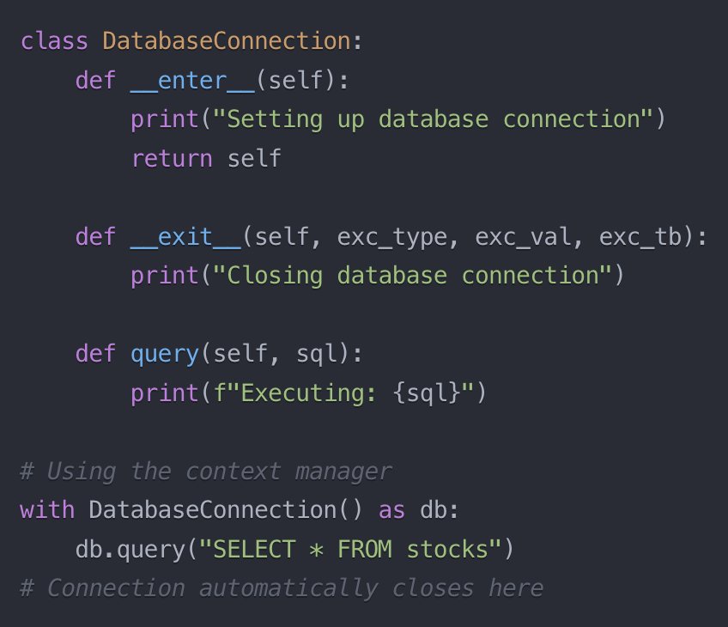
Context Managers
Purpose
- Automate the setup and cleanup of resources
- Ensure resources are properly managed, even if errors occur
- Make code cleaner and more reliable
Resource Management
- Automatically handle opening/closing of files
- Release database connections
- Clean up temporary resources
- Manage locks and threading resources
Common Use Cases
- File handling (with open() as f)
- Database connections
- Network connections
- Temporary directory management
- Performance timing and monitoring

Slide 29
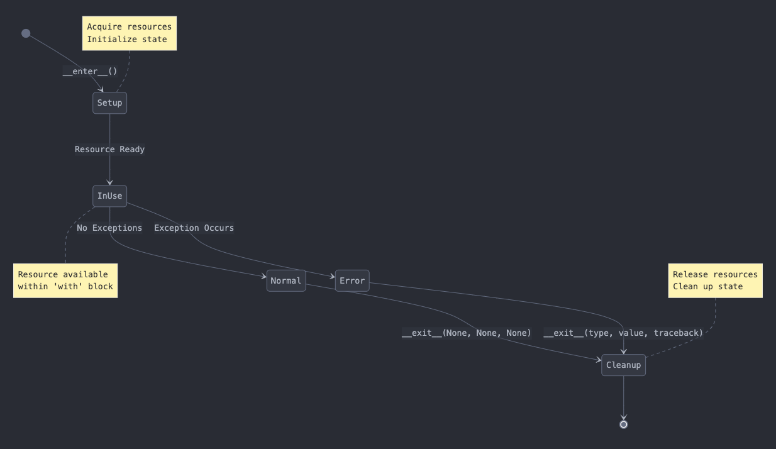
Context Managers

Slide 30
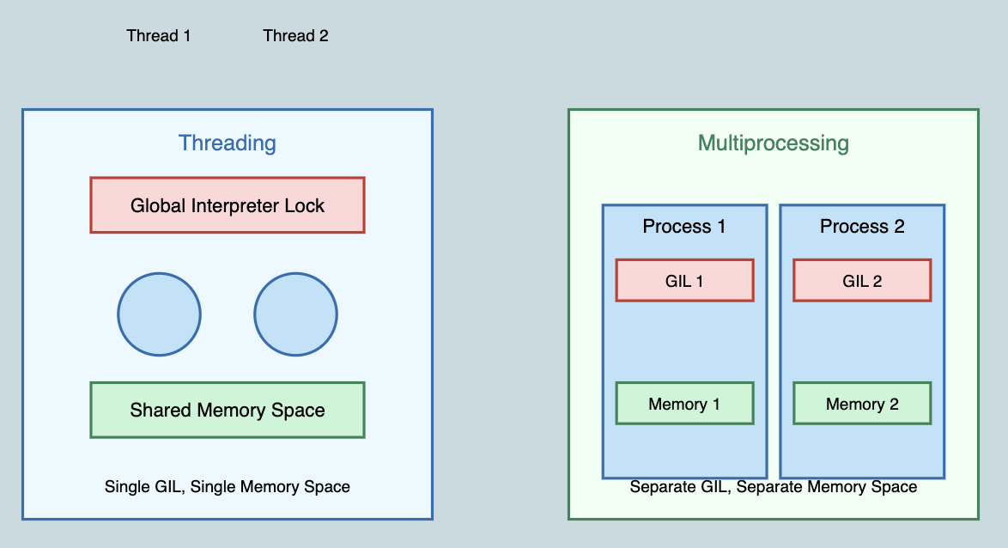
Concurrency Deep Dive
Threading vs Multiprocessing
- Threading: Multiple threads share memory space
- Multiprocessing: Separate memory for each process
- GIL: Only one thread executes Python code at a time
When to Use Each
- Threading: I/O-bound tasks (API calls, file operations)
- Multiprocessing: CPU-bound tasks (data processing)
- Threading for concurrency, Multiprocessing for parallelism
Common Patterns
- Thread pools for managing multiple connections
- Process pools for parallel computations
- Producer-consumer patterns
- Lock mechanisms for shared resources

Slide 31
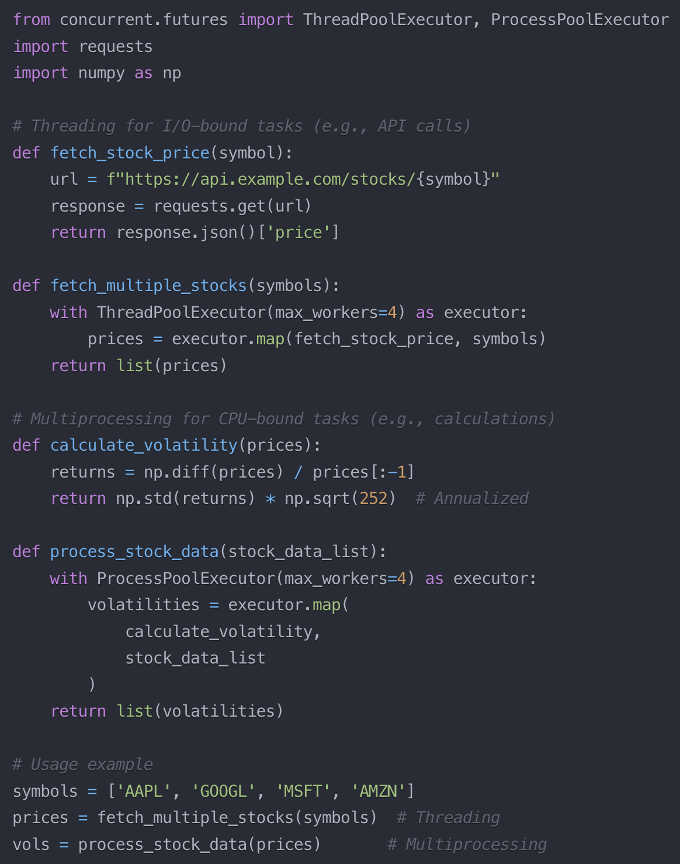
Concurrency Deep Dive
Threading vs Multiprocessing
- Threading: Multiple threads share memory space
- Multiprocessing: Separate memory for each process
- GIL: Only one thread executes Python code at a time
When to Use Each
- Threading: I/O-bound tasks (API calls, file operations)
- Multiprocessing: CPU-bound tasks (data processing)
- Threading for concurrency, Multiprocessing for parallelism
Common Patterns
- Thread pools for managing multiple connections
- Process pools for parallel computations
- Producer-consumer patterns
- Lock mechanisms for shared resources

Slide 32
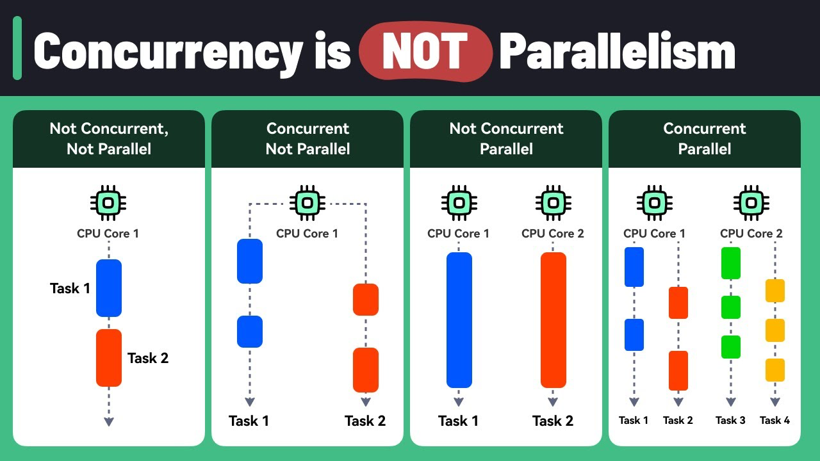
Async Programming Basics
Concurrency vs Parallelism
- Concurrency: Managing multiple tasks by switching between them
- Parallelism: Executing multiple tasks simultaneously on multiple cores
Common Async Patterns
- async/await syntax for clean asynchronous code
- Gather multiple coroutines to run concurrently
- Task scheduling and cancellation
- Event loops for managing async operations
When to Use Async
- I/O-bound operations (API calls, database queries, file operations)
- Multiple independent network requests
- Long-running tasks that can be interleaved
- Real-time data processing (market data feeds, streaming)

Slide 33
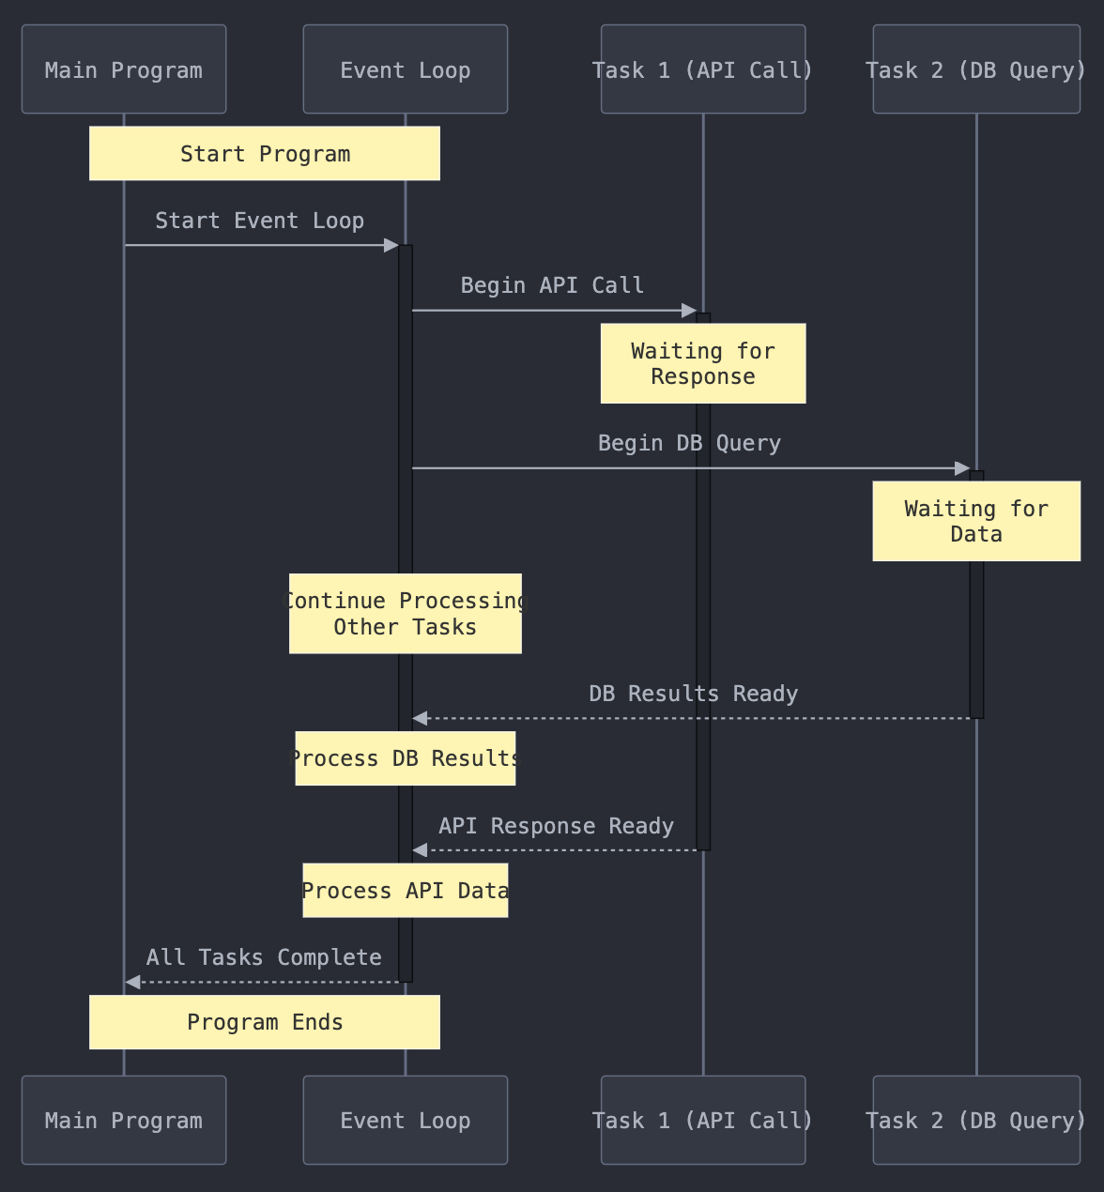
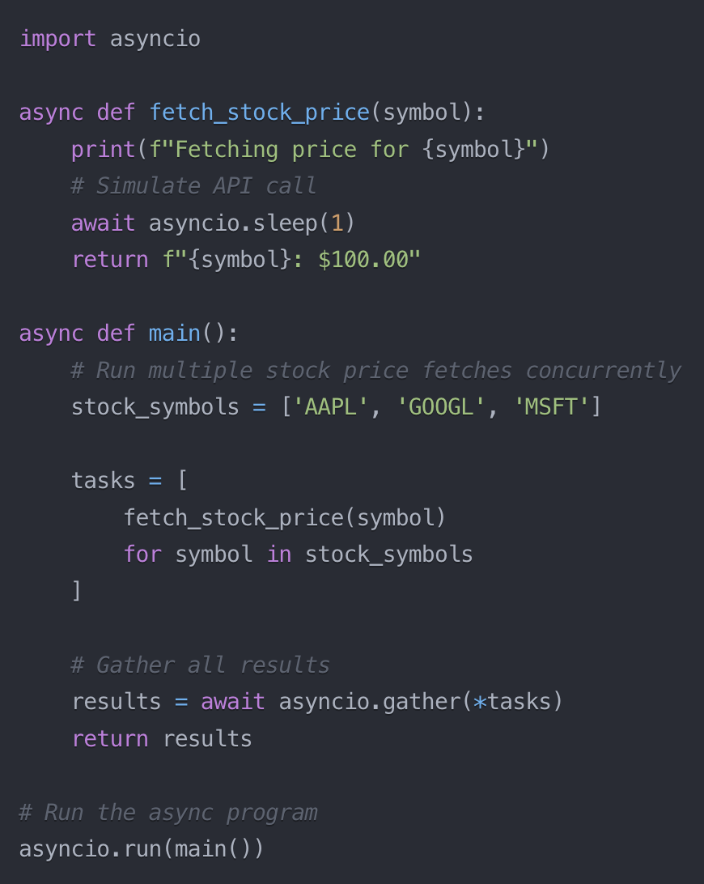
Async Programming Basics

Slide 34
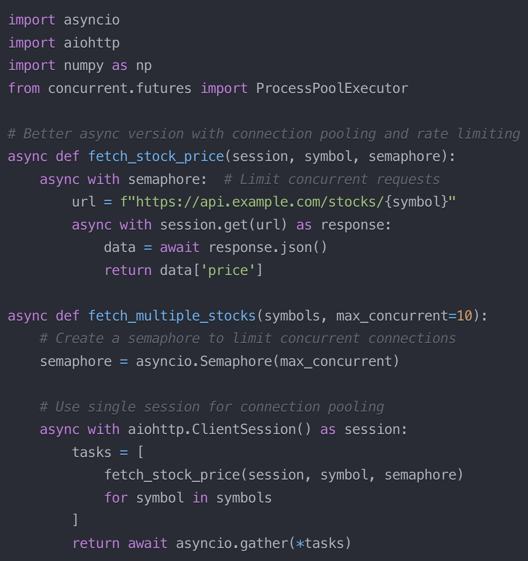
Asyncio + Semaphore
Why Asyncio + Semaphore is Better
Connection & Resources
- Single session reuses TCP connections
- Semaphore prevents API overload
- More efficient memory and CPU usage
Performance
- No thread overhead - pure async I/O
- Handles 1000s of concurrent requests
- Ideal for real-time market data feeds
Simple Control
- Clean error handling
- Easy rate limiting
- Built-in connection pooling

Slide 35
Production Best Practices

Slide 36
Error Handling
Exception Hierarchy
- BaseException → Exception → Your Custom Errors
- Built-in errors: ValueError, TypeError, KeyError
- Catch specific exceptions, not catch-all
- Order from specific to general
Best Practices
- Catch specific exceptions, not bare except
- Keep try blocks small and focused
- Always clean up resources in finally
- Log exceptions with context
EAFP: "Easier to Ask Forgiveness than Permission"
- Commonly uses try/except blocks to handle potential errors
- Encourages optimistic coding, assuming success until an exception proves otherwise
LBYL: "Look Before You Leap"
- Relies on conditional checks to verify assumptions before performing an action
- May lead to more verbose code, but reduces reliance on exception handling
- Python prefers EAFP (try/except)
- More readable and handles race conditions

Slide 37
Logging Best Practices
Logging Levels
- DEBUG: Detailed troubleshooting
- INFO: General operational events
- WARNING: Unexpected but handled issues
- ERROR: Failed operations
- CRITICAL: System-level failures
Structured Logging
- JSON format for machine readability
- Consistent fields across logs
- Contextual data (timestamps, IDs)
- Easy to parse and analyze
Log Handlers
- File handlers for persistence
- Stream handlers for monitoring
- Rotating handlers for size management
- Different handlers per level
Best Practices
- Never log sensitive data (passwords, keys)
- Include request/transaction IDs
- Log exceptions with tracebacks
- Keep messages clear and actionable

Slide 38
